Slide 1
Working with Users, Groups, and Permissions

Slide 2
Introduction to users
whoami -command tells you your username.
who - command will give you information about who is logged on the system.
w - command shows you who is logged on and what they are doing
id- command will give you your user id, primary group id, and a list of the groups that you belong to

Slide 3

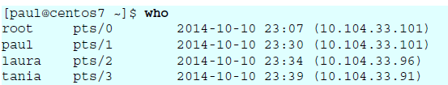
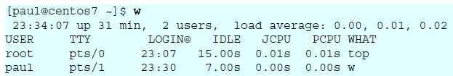


Slide 4
su -command allows a user to run a shell as another user.
su tania
su to become root, when you know the root password
su root
su
To become another user and also get the target user's environment, issue the su - command followed by the target username.
su – laura
To run a program as another user
The sudo program allows a user to start a program with the credentials of another user.
the system administrator has to set up the /etc/sudoers file.
This can be useful to delegate administrative tasks to another user (without giving the root password).

Slide 5
Managing Users and Groups
useradd -This command is used for adding users to the local authentication system.
usermod -This command is used to modify properties for existing users.
userdel- This command is used to delete users properly from a system
The useradd command has a few options. If an option is not specified, useradd will read its configuration file in /etc/default/useradd

Slide 6

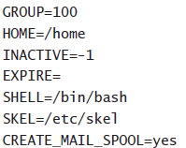
To add a user named yanina (last parameter) and at the same time forcing the creation of the home directory (-m), setting the name of the home directory (-d), and setting a description (-c).

Slide 7
Group Membership-a user can be a member of two different kinds of groups: the primary group and all other groups
UID-all users need a unique UID. Linux starts generating local UIDs at 500. The highest UID available by default is 60000
UIDs below 500 are reserved for system accounts
UID 0 is typically reserved for the user root.

Slide 8
Shell-To log in to a server, every user needs a shell . The shell will enable interpretation of commands the user enters from their console.
The default shell in Linux is /bin/bash.
For example, /sbin/nologin can be used if you don’t want to allow the user any interaction with your system locally

Slide 9


/etc/passwd
The local user database on Linux is /etc/passwd
this file contains seven columns separated by a colon.
the username, an x, the user id, the primary group id, a description, the name of the home directory, and the login shell.

Slide 10
Different fields are used in /etc/passwd.
Username -The user’s login name is stored in the first field
Password- Encrypted passwords were stored in this file.
UID- every user has a unique user ID.
GID-every user has a primary group
GECOS -The General Electric Comprehensive Operating System (GECOS) field is used to include some additional information about the user
Home Directory
Shell -The last field refers to the shell of user

Slide 11
Managing Passwords
Passwords-The passwd command is easy to use. A user can use it to change his password
Performing Account Maintenance with passwd
the passwd command has some options available.
-l Enables an administrator to lock an account. For example,
passwd -l lucy will lock the account for user lucy.
-u Unlocks an account that has been locked before.
-S Reports the status of the password for a given account.
-e Forces the user to change their password on next login.

Slide 12
The user root can use the passwd command in three generic ways
for password maintenance—to change a password
to set password expiry information
to lock an account so that login is disabled temporarily

Slide 13
Managing Password Expiry-options to manage account expiry
-n min -To set the minimum number of days that a user must use their password.
-x max -to set the maximum number of days a user can use a password without changing it.
-c warn - When a password is about to expire, you can use this option to send a warning to the user.
-i inact - Use this option to expire an account automatically when it hasn’t been used for a given period of time.

Slide 14
Modifying and Deleting User Accounts
You can modify the properties of a user with the usermod command
#usermod [option] [argument] username
-g --gid Used to change user’s primary group
-c --comment Used to update description field
-d --home Used to change home directory.
-m --move-home Used to create a new home directory and move all the contents from current directory to new directory.
-s --shell Used to update the login shell
-l --login Used to change the login name
-L --lock Used to lock the account
-U --unlock Used to unlock the account

Slide 15
To make sure user linda is removed, including all files in her home directory, use
userdel –rf linda.
to locate all files on your system that are created by linda and remove them automatically, you can use
find / -user "linda" -exec rm {} \;
find / -user linda -exec mv {} /trash/linda \;

Slide 16
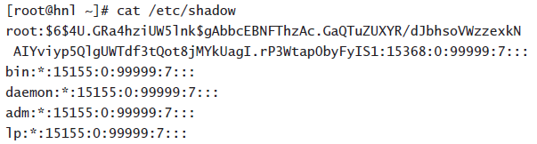

/etc/shadow
The encrypted user passwords are stored in /etc/shadow. Information relating to password expiry is also kept in this file
If an ! is used, login is currently disabled.
If an * is used, it is a system account that can be used to start services

Slide 17
Here are the fields used in the lines in /etc/shadow:
Login name
Encrypted password
Days since January 1, 1970 that password was last changed
Days before password may be changed
Days after which password must be changed
Days before password is to expire that user is warned
Days after password expires that account is disabled
Days since January 1, 1970, that account is disabled
Reserve field, not currently used

Slide 18
/etc/login.defs
/etc/login.defs is a configuration file that relates to the user environment but is used completely in the background

Slide 19
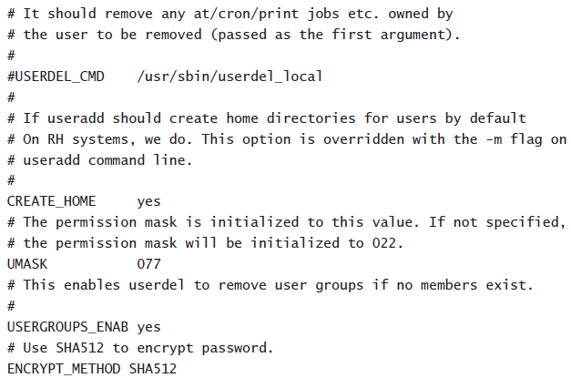

Slide 20
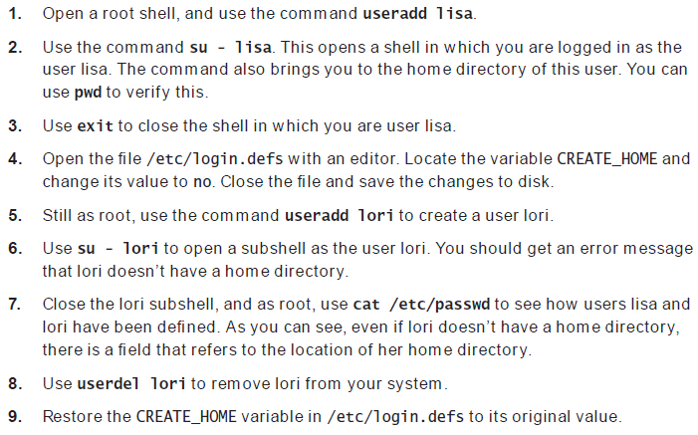
Creating Users

Slide 21
Primary and Secondary groups
Two types of groups — primary and secondary.
The primary group is the one that’s recorded in the /etc/passwd file, configured when an account is set up. When a user creates a file, it’s their primary group that is associated with it is created
Secondary groups are those that users might be added to once they already have accounts. Secondary group memberships show up in the /etc/group file.

Slide 22
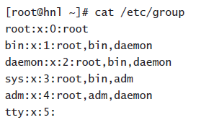
Creating Groups
There are three commands to manage the groups in your environment: groupadd, groupdel, and groupmod.
groupadd somegroup
When creating groups, the first available group ID (GID) is assigned automatically.
If you want to specify the GID use the option -g.

Slide 23
/etc/group
Managing Group Membership
To manage group membership, you can use the usermod and groupmod commands
-g ,--gid GROUP This option is used to set the primary group for the user.
-G, --groups GROUPS Use this option to define a new list of supplementary groups.
-a, --append Use this option together with -G to add new supplementary groups to the current list of supplementary groups
if you want to add supplementary group sales to user linda,
usermod –Ga sales linda

Slide 24

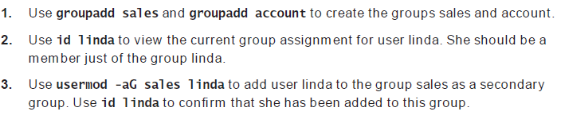

Slide 25
Using Graphical Tools for User and Group Management

Slide 26
https://forms.gle/3TTsn5MgjdFjGDtH8

Slide 27
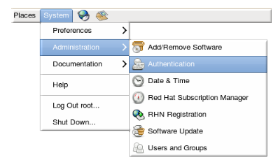
Using External Authentication Sources
system-config-authentication tool
authconfig

Slide 28
There are two configuration tabs in the Authentication dialog box:
Identity & Authentication, which configures the resource used as the identity store (the data repository where the user IDs and corresponding credentials are stored).
Advanced Options, which allows authentication methods other than passwords or certificates, like smart cards and fingerprint.

Slide 29
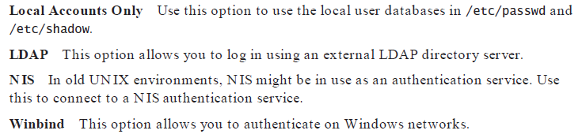
Four options are offered by default:

Slide 30
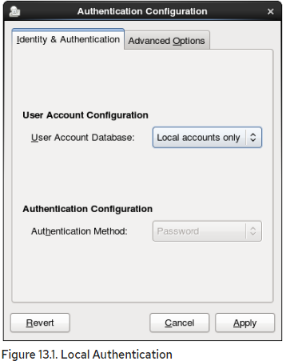

Slide 31
Connecting to an LDAP Server
To connect to the LDAP server, it is good practice to use TLS to encrypt connections.
The second part of the configuration of LDAP authentication consists of selecting an authentication method.

Slide 32
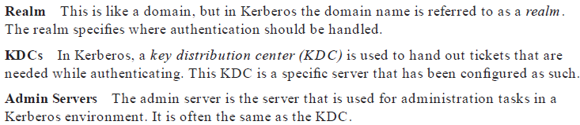
Configuring LDAP Authentication

Slide 33
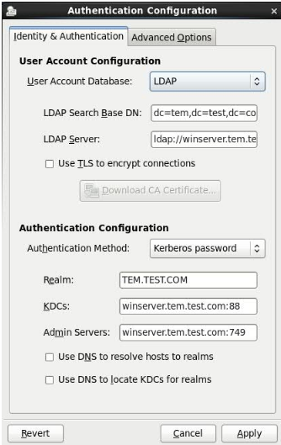

Slide 34
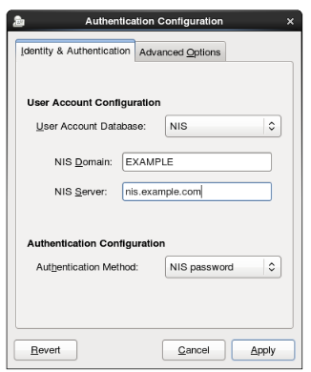

Slide 35
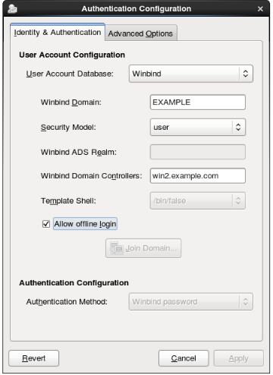
Connecting to an Active Directory Server

Slide 36
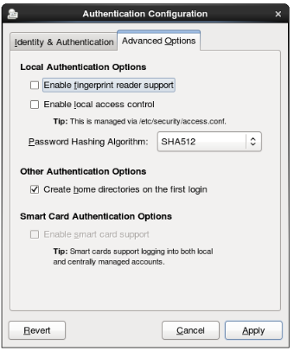
Configuring Alternative Authentication Features

Slide 37
Understanding the Authentication Process
To configure authentication against an external authentication server, the sssd ,PAM and /etc/nsswitch.conf also play a role.
Understanding sssd
provides information about all available authentication sources
The configuration parameters you’ve specified are written to the configuration file /etc/sssd/sssd.conf.

Slide 38
Understanding nsswitch
The /etc/nsswitch file is used to determine where different services on a computer are looking for configuration information. The different.
Understanding Pluggable Authentication Modules
pluggable authentication modules (PAM) are what is used to make authentication pluggable
There are two parts in PAM
configuration file in the directory /etc/pam.d.
configuration file /etc/pam.d/login

Slide 39
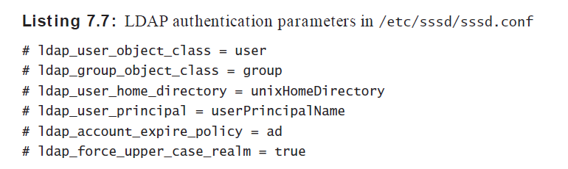
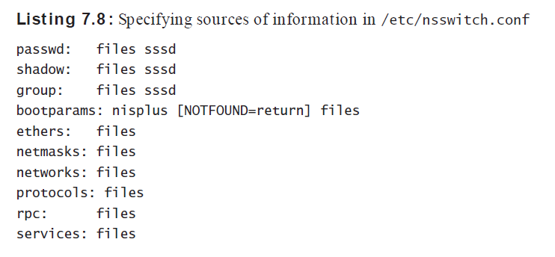

Slide 40
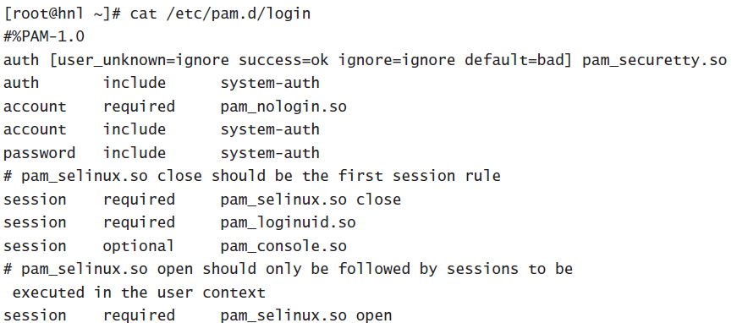
In the first column, the authentication process is split into four different phases:
auth, account, password, and session

Slide 41
Managing Permissions
Displaying Ownership
ls -l command. This command shows the user as well as the group owner.
the command find / -user linda shows all files that have user linda as their owner.
Changing User & Group Ownership
command chown linda account would change ownership for the file account to user linda.
command chgrp account /home/account can be used to set group ownership for the directory /home/account to the group account.

Slide 42
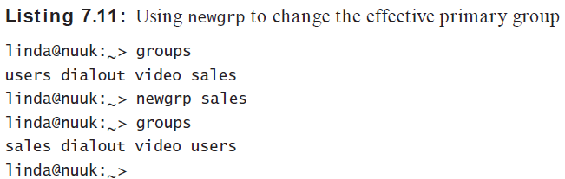
Default Ownership
To show the current effective primary group, a user can use the groups command as follows:

Slide 43
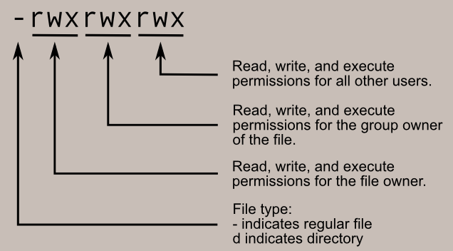
Basic Permissions: Read, Write, and Execute

Slide 44
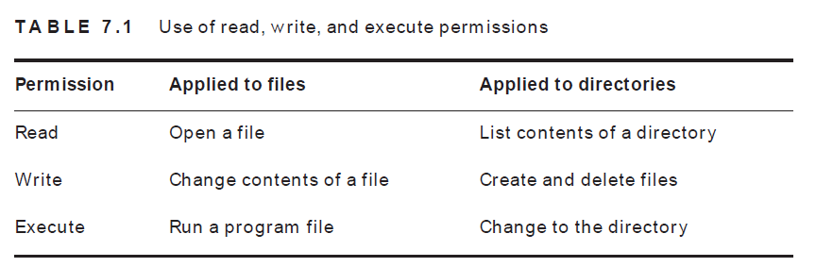

Slide 45
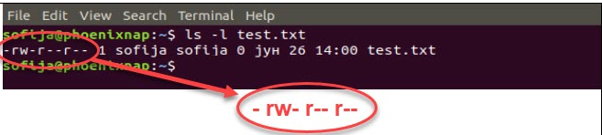

Slide 46
chmod
When using chmod, you can set permissions for user, group, and others.
this command works in two modes:
absolute
relative

Slide 47
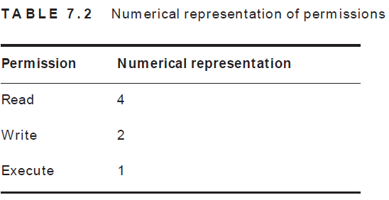
absolute mode
chmod [permission] [file_name]
Therefore, the possibilities are:
7 – for read, write, and execute permission
6 – for read and write privileges
5 – for read and execute privileges
4 – for read privileges

Slide 48
Accessible Types
Permission Counters
7 : 4 + 2 + 1 = r + w + x
5 : 4 + 0 + 1 = r + x
5 : 4 + 0 + 1 = r + x
if you want to set read, write, execute for the user, read and execute for the group, and read and execute for others on the file /somefile,
chmod 755 /somefile.

Slide 49
relative mode
chmod in relative mode, you work with three indicators user (u), group (g), and others (o).
chmod u=rwx,g=rwx,o=rwx [file_name]
would add the write permission to the group and remove read for others.

Slide 50
Example :To set permission on test.txt to be: • read and write for the user • read for the members of the group • read for other users
Use the following command:
chmod u=rw,g=r,o=r test.txt

Slide 51
$ touch sample.txt
$ ls -l sample.txt
-rw-r--r-- 1 username group 0 1 10 10:11 sample.txt
# user = can read and write
# group = can read only
# others = can read only
# changes permission of sample.txt
$ chmod 755 sample.txt
$ ls -l sample.txt
-rwxr-xr-x 1 username group 0 1 10 10:11 sample.txt
# other options
# - target : u, g, o
# - control : +, -, =
# - type : r, w, x
$ chmod ug+rx sample.txt
$ ls -l sample.txt
-rwxr-x-- 1 username group 0 1 10 10:11 sample.txt

Slide 52
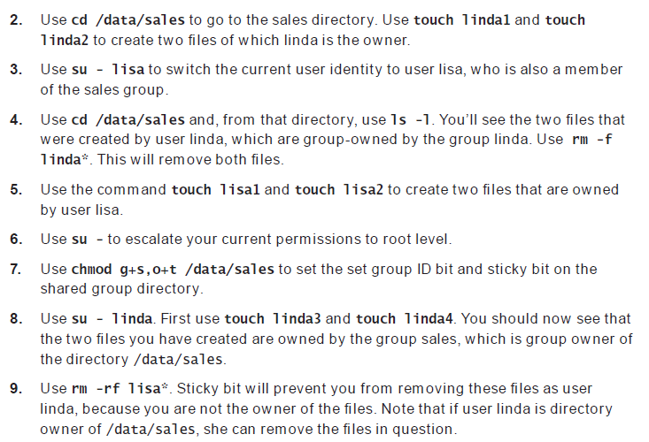

Slide 53
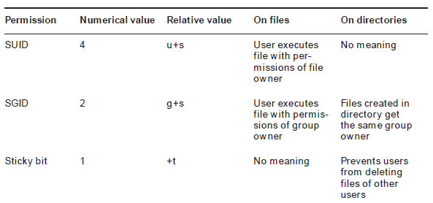
Understanding Advanced Permissions
There are three advanced permissions
set user ID (SUID) permission
set group ID (SGID)
Sticky bit permission is used to protect files against accidental deletion in an environment

Slide 54
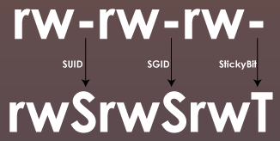

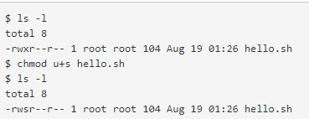
SUID Bit

Slide 55
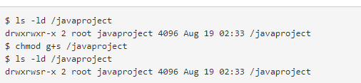
SGID Bit
SGID bit works on both files and directories, when any user executes a file with SGID bit set on it, it will always be executed with the group ownership of that file, irrespective of who is running it.
SGID on directories is used for creating collaborative directories

Slide 56

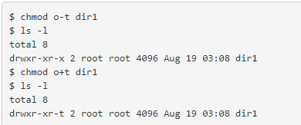
Sticky bit
The sticky bit works on directories only. If a user wants to create or delete a file/directory in some directory, he needs write permission on that directory. The write permission on a directory gives a user the privilege to create a file as well as the privilege to remove it.

Slide 57
Working with Access Control Lists
access control lists (ACLs)-To give permissions to more than one user or one group on the same file
To see your current ACL settings, you need to use getfacl
To set ACLs, you need to use the setfacl command

Slide 58
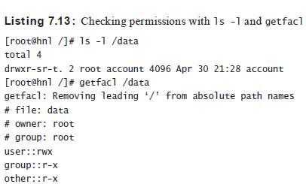

Slide 59
setfacl -m g:sales:rx /data.
In this command, -m indicates that the current ACL settings need to be modified. After that,
g:sales:rx tells the command to set the ACL to read and execute (rx) for the group (g) sales
To set a default ACL,
you have to add the option d after the option –m.
setfacl -m d:g:sales:rx /data

Slide 60
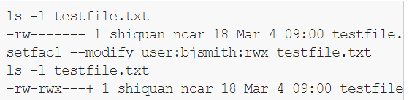
User shiquan is sharing a file testfile.txt with user bjsmith. Listing the file before and after creating the ACL shows how the file permissions changed. The + in the last line indicates that an ACL has been created for the file.

Slide 61
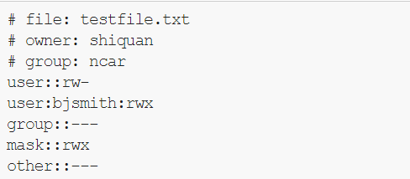
getfacl testfile.txt

Slide 62
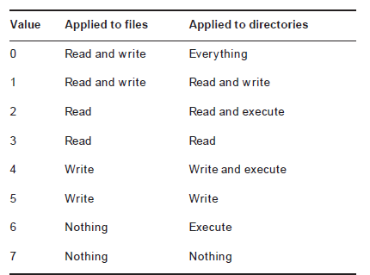
Setting Default Permissions with umask
To change the default permissions that are set when you create a file or directory within a session or with a script, use the umask command.
The maximum setting for files is 666 and for directories is 777.

Slide 63
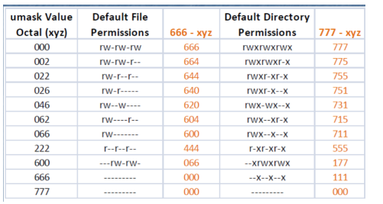

Slide 64
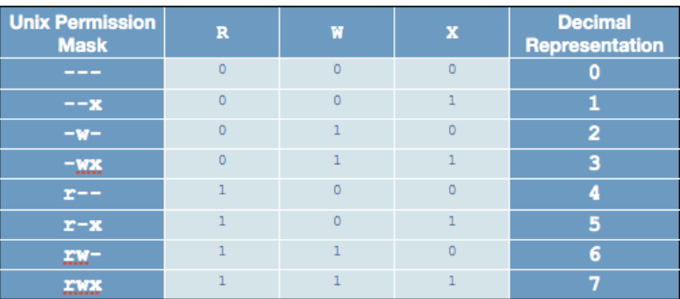

Slide 65
In Linux, the default permissions value is 666 for a regular file, and 777 for a directory.
When creating a new file or directory, the kernel takes this default value, "subtracts" the umask value, and gives the new files the resulting permission
if our umask value is 022, then any new files will, by default, have the permissions 644 (666 - 022).
Likewise, any new directories will, by default, be created with the permissions 755 (777 - 022).

Slide 66
Working with Attributes
chattr command- to apply attributes
chattr +s somefile
to remove the attribute
lsattr command -To get an overview of all attributes that are currently applied

Slide 67
https://www.youtube.com/watch?time_continue=5&v=D-VqgvBMV7g&feature=emb_logo
https://forms.gle/JumnxqxkC6gJng266
https://forms.gle/SFX6Pg6TkYYndJLg7

